Slide 1


Analysis with the Python API
Andrew Chapkowski
George Bochenek
Notes:
G208582 FedGIS Conference 2019 Template for Esri staff

Slide 2
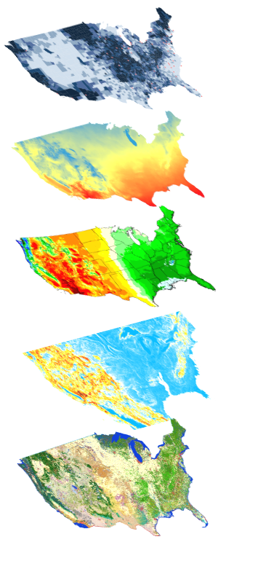
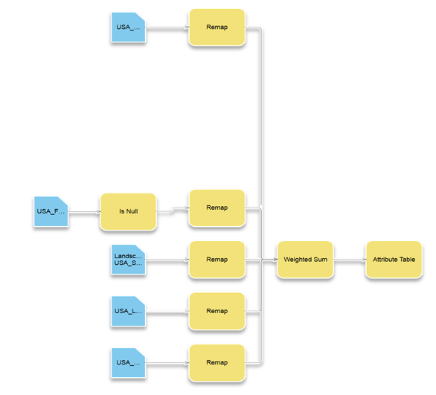
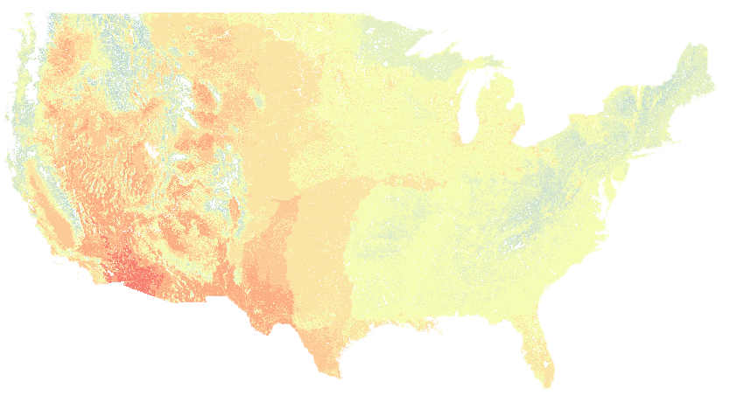


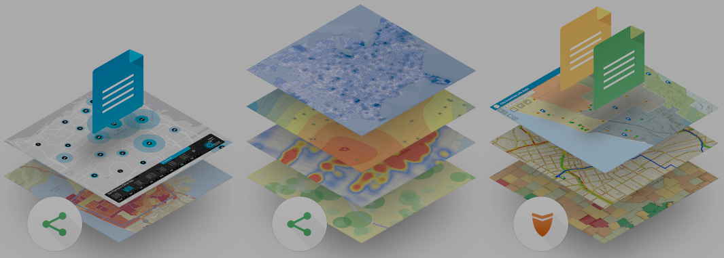
ArcGIS API for Python What can it do for you?
Big Data
Spatial Analysis
Raster Analytics
Imagery
Location Analytics
Feature Analytics
Platform API
Power Users
Developers
Analysts
Data Scientists
Enterprise Integration
Users, Roles & Group management
Administrators
DevOps
Content Publishers
Your Web GIS
A Pythonic representation of GIS
Data Management

Slide 3
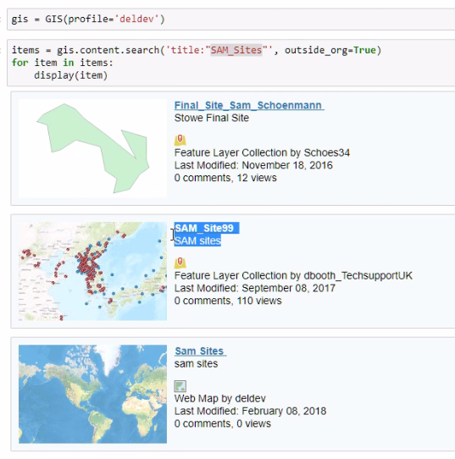
Data Science with ArcGIS - Data
Esri curated content – Living Atlas
Multi-spectral, temporal, dynamic imagery layers
Landsat, NAIP, MODIS, Elevation
Basemaps, Imagery, Demographics, Transport
Boundaries & places, Landscape, Oceans
Earth Observations, Urban Systems, Historical Maps, …
Your data, org’s data, data shared with you
Shapefiles, File geodatabase, CSV, Excel, HTML, …
File shares, cloud share
HDFS, Hive and databases
Public data
Maps, layers and datasets shared by users worldwide

Slide 4
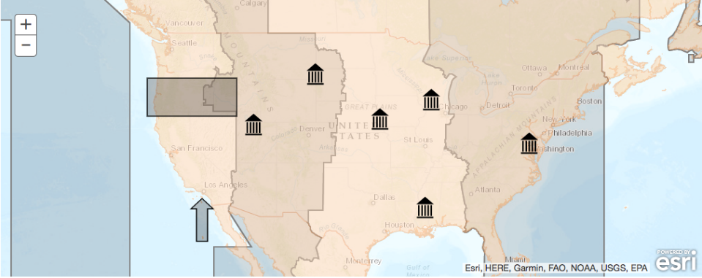
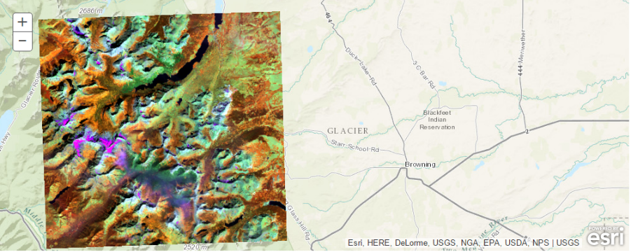
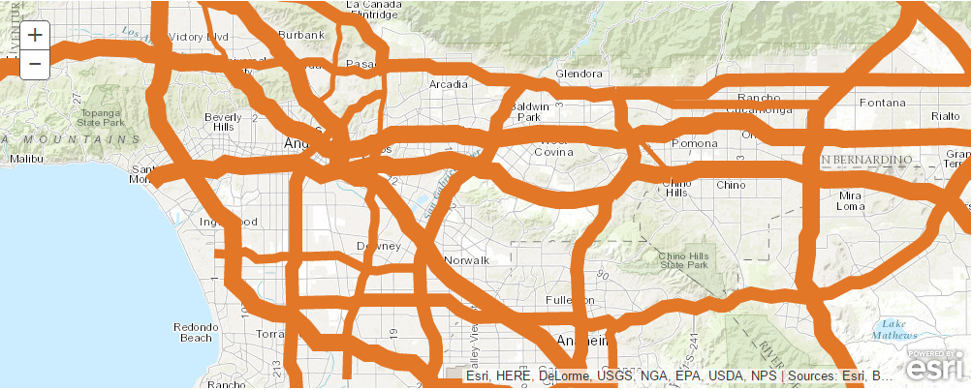
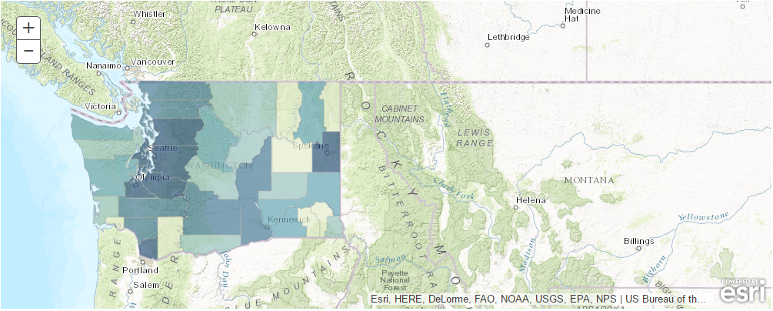
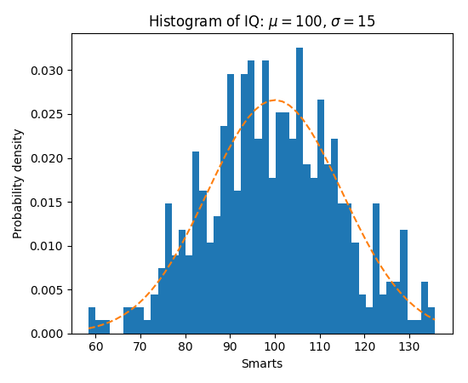
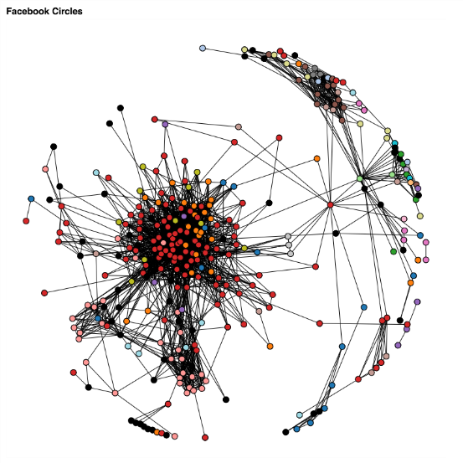
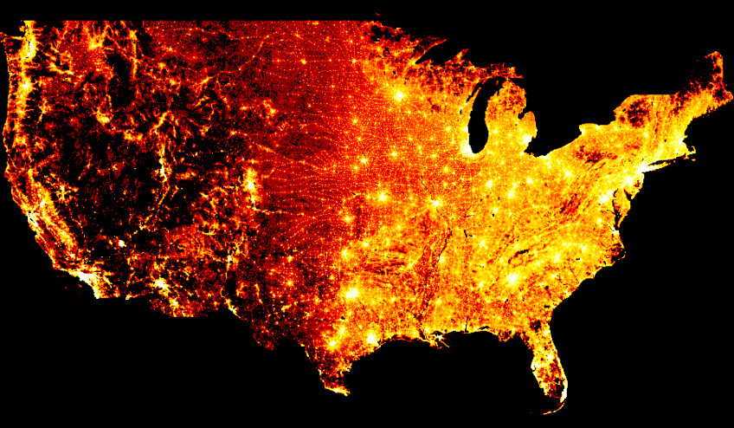
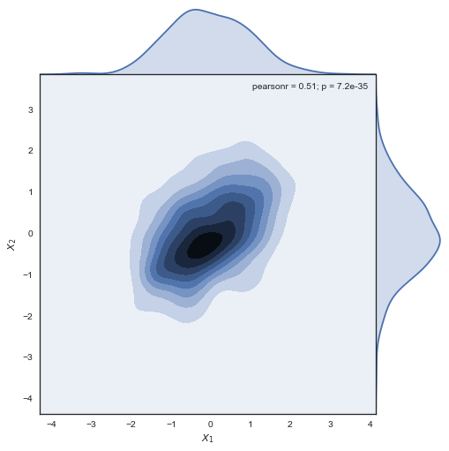
Data Science with ArcGIS - Visualization
Visualize with ArcGIS
Map widget in Jupyter notebook
Web Maps and Web Scene
Feature layers
Raster and imagery layer
Smart mapping
Pythonic renderers and symbology
Visualize with Python
Matplotlib, Seaborn, Bokeh, Plotly, …
Datashader, Holoviews, Mayavi, …

Slide 5
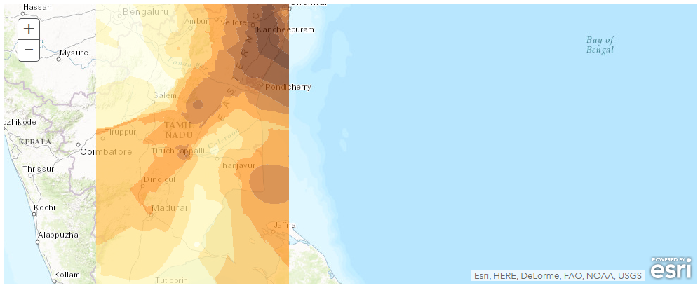
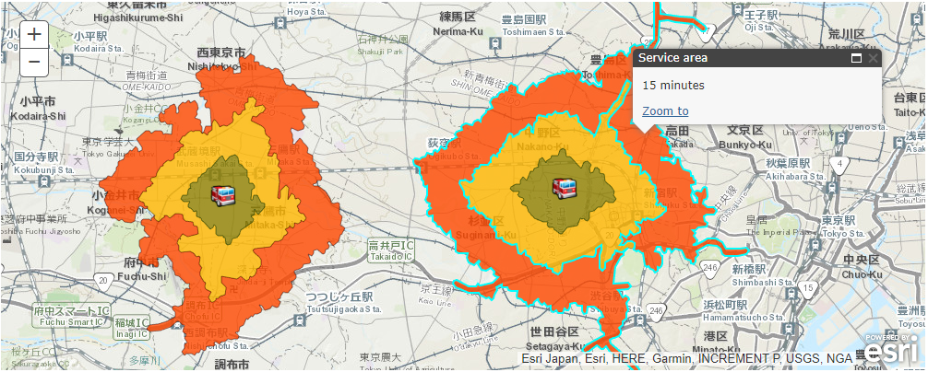
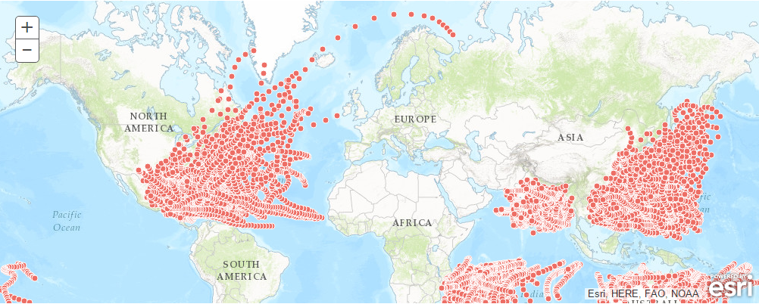
Data Science with ArcGIS - Analysis
Analysis with ArcGIS
Geoprocessing in Web GIS
Spatial analysis, Routing and directions
Network analysis, Geocoding, Geoenrichment…
Imagery and Raster Analysis
On the fly dynamic image processing
Distributed raster analysis
GeoAnalytics – large tabular and vector data
Machine/Deep Learning

Slide 6
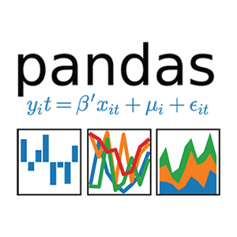

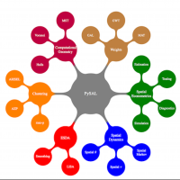





Data Science with ArcGIS - Analysis
Analysis with Python libraries
Data wrangling
Pandas, numpy, scipy
Machine learning
Scikit-learn, tensorfly, keras, pytorch, fastai
Geospatial analysis
PySAL, GDAL, Shapely, Fiona, …
Image processing and computer vision
PIL, OpenCV, scikit-image

Slide 7
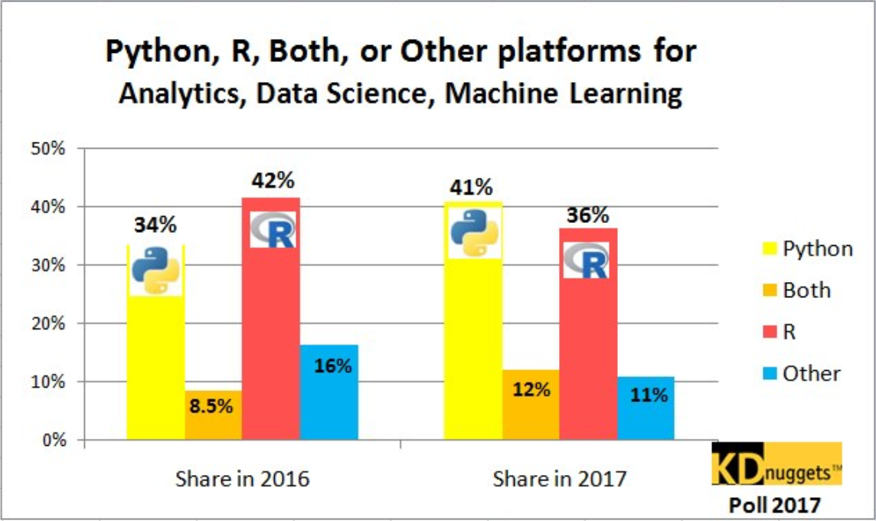

Why Python?
Popularity
Productivity
Interoperability
Solves the “two-language” problem
Scientific Python ecosystem
Community

Slide 8
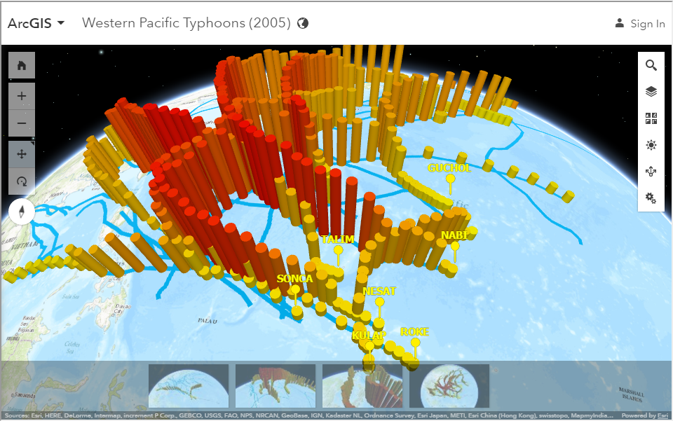
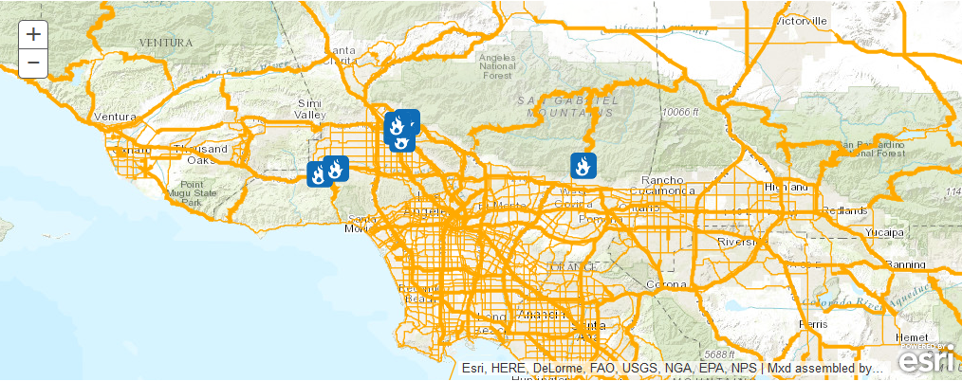
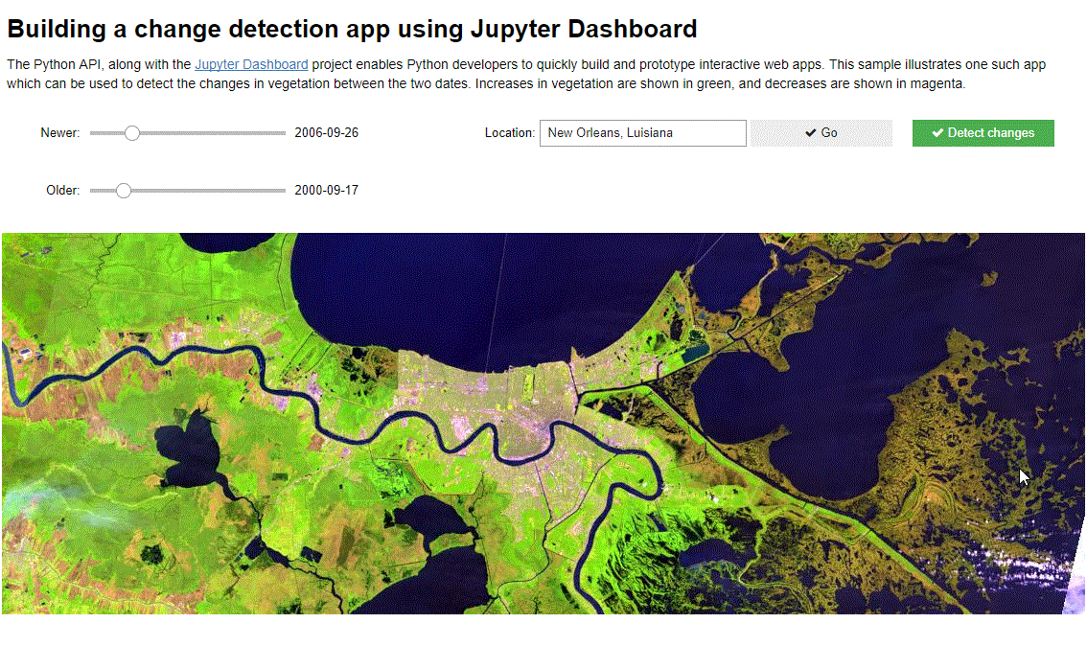
Data Science workflows - Deployment
Deploy as information products
WebMaps
Web scenes
Layers
Deploy as web tools
Geoprocessing script tools
Binder projects
Deploy as dashboards
ArcGIS Operations Dashboard
Jupyter dashboard
Plotly dashboard

Slide 9
ArcGIS API for Python Overview
geo
analytics
gis
geo
processing
geo
enrichment
geocoding
raster
geometry
features
mapping
realtime
env
widgets
schematics
network

Slide 10



Slide 11
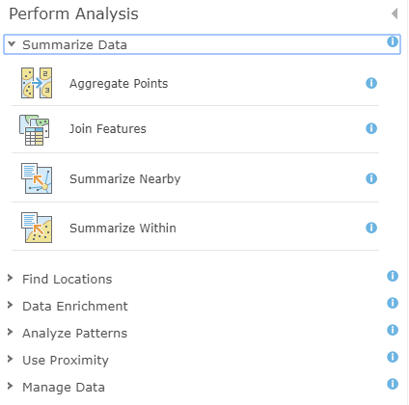
Spatial Analysis Tools
Summarize Data
Find Locations
Data Enrichment
Analyze Patterns
Use Proximity
Manage Data

Slide 12
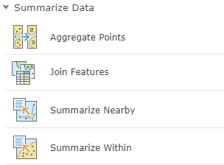
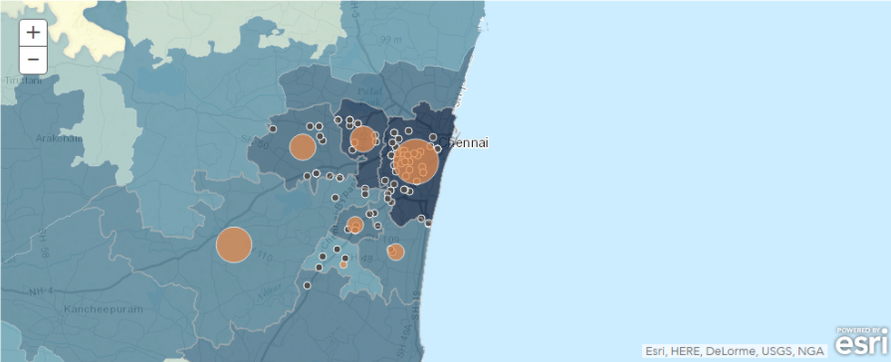
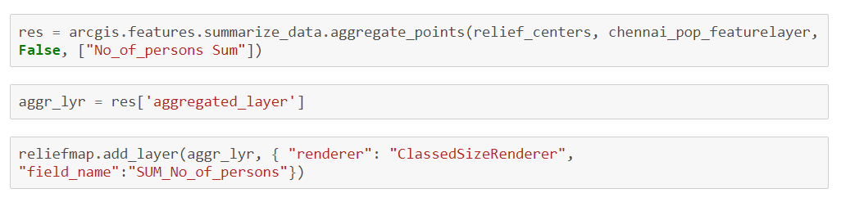
Summarize Data
Calculate summary statistics for features and attributes

Slide 13
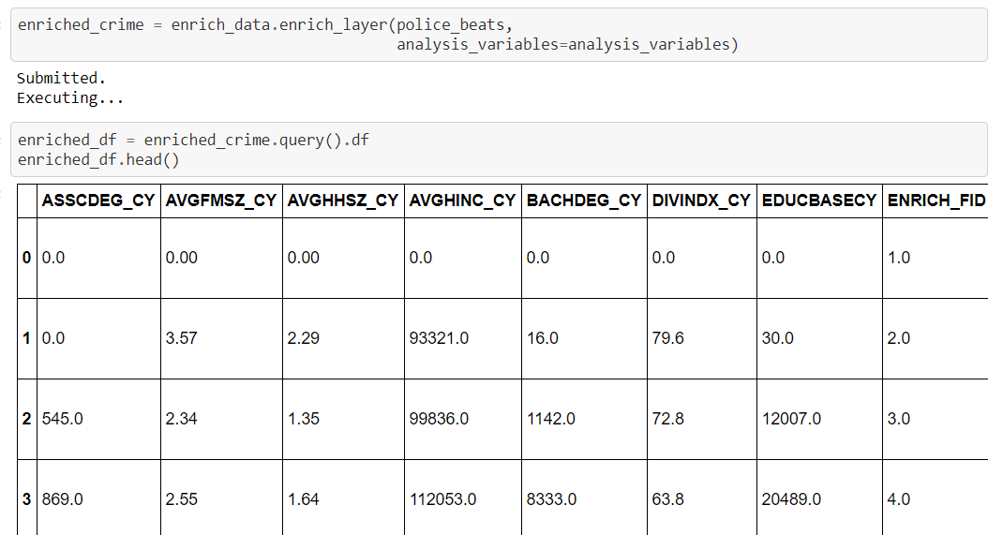
Enrich Layer
Add detailed demographic data and statistics to your analysis

Slide 14
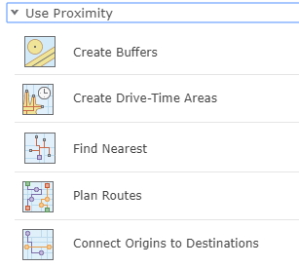
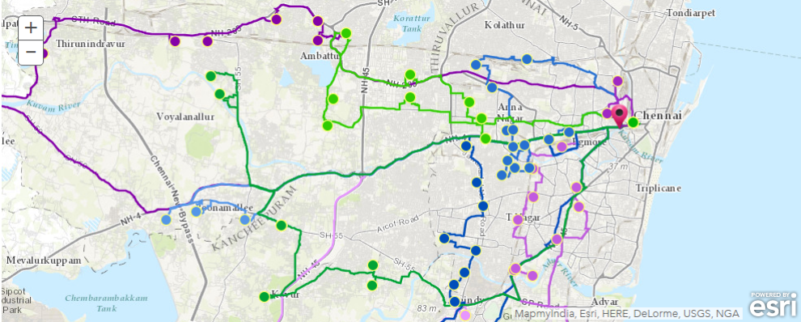
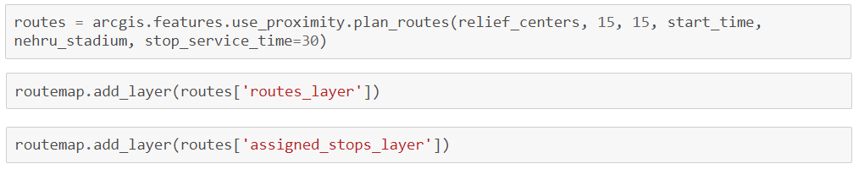
Use Proximity
“What is near what?”

Slide 15
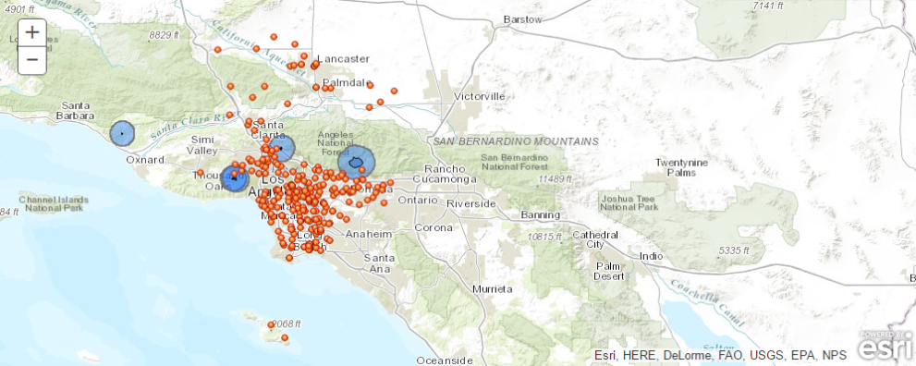
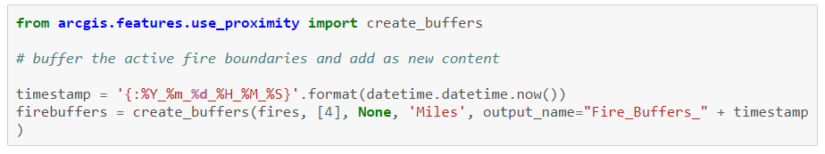
Use Proximity
“What is near what?”

Slide 16
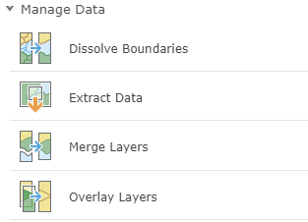
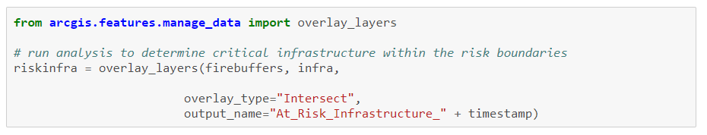
Manage Data
Manage geographic data, overlay layers

Slide 17
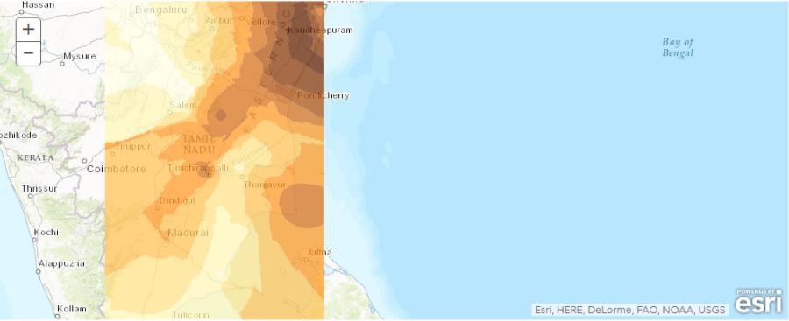
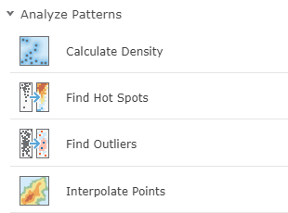
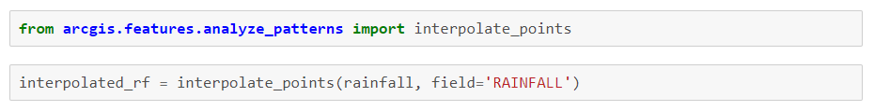
Analyze Patterns
Identify, quantify, and visualize spatial patterns in your data.

Slide 18

Demo
Features Module
GIS in Python

Slide 19

Imagery and Raster Analysis
On-the-fly and distributed batch analysis of raster data
arcgis.raster module

Slide 20
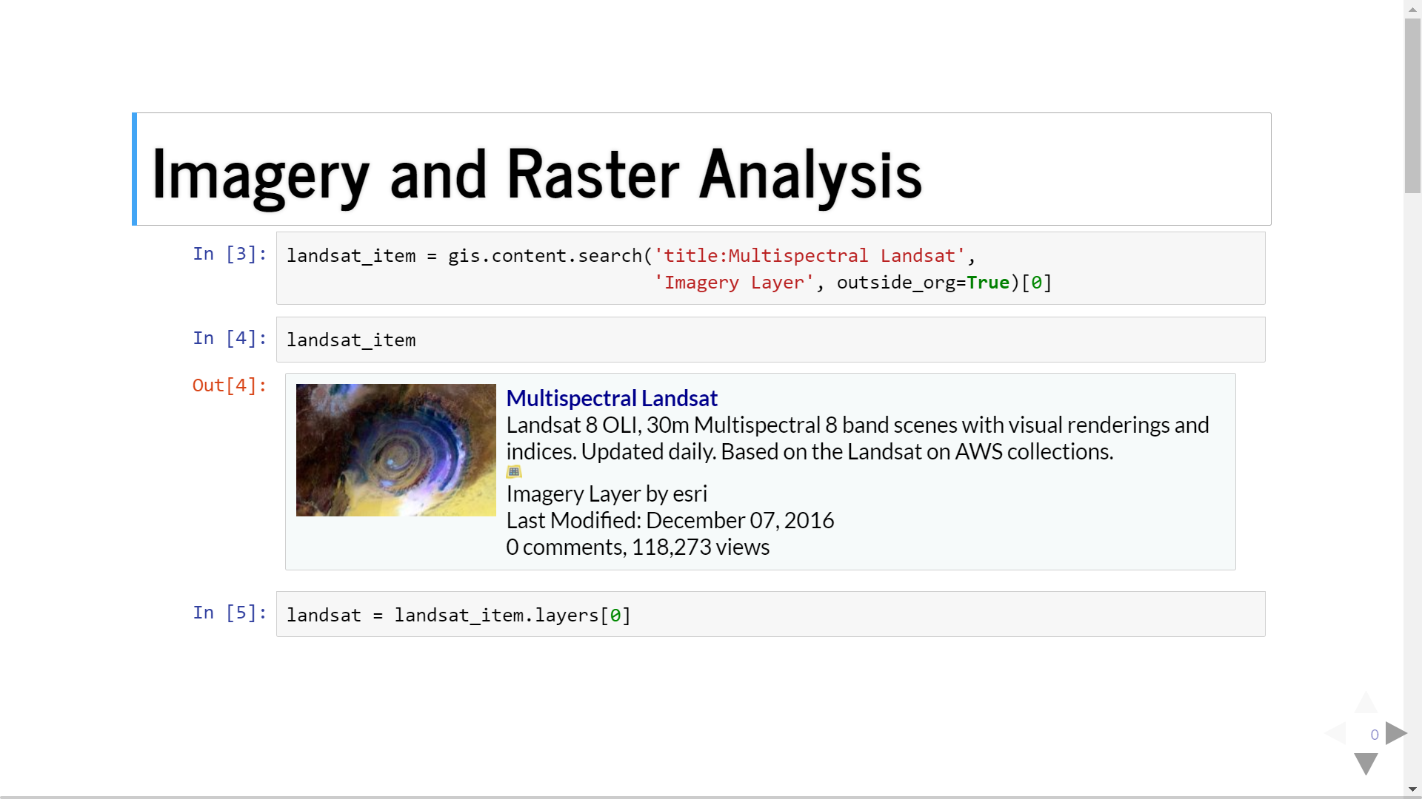

Slide 21
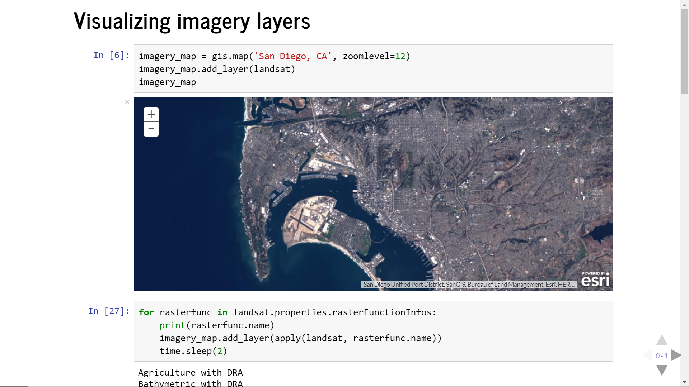

Slide 22
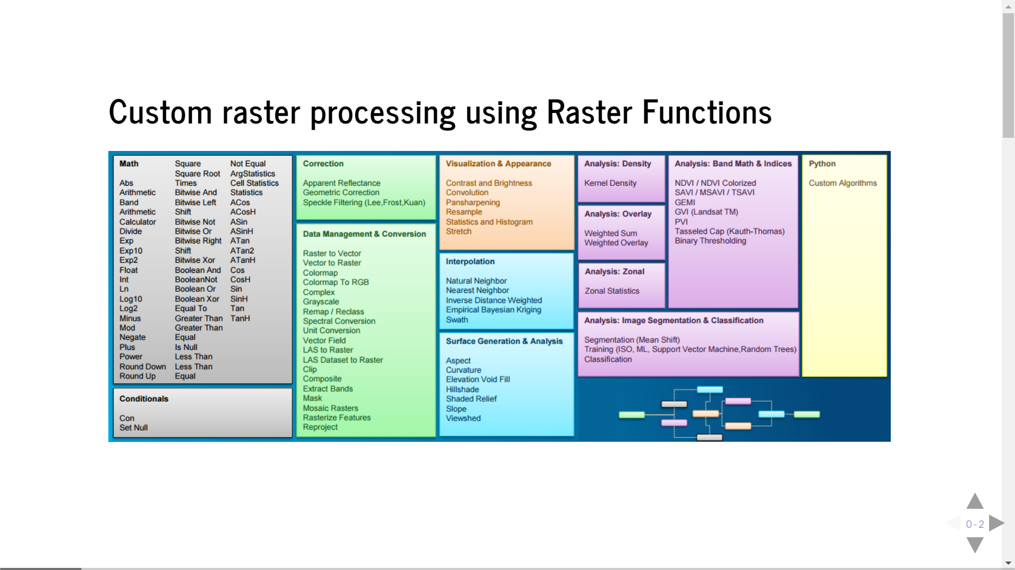

Slide 23
Demo
Raster Module
GIS in Python

Slide 24
Geocoding
Geocoding, Batch geocoding, reverse geocoding
arcgis.geocoding module

Slide 25
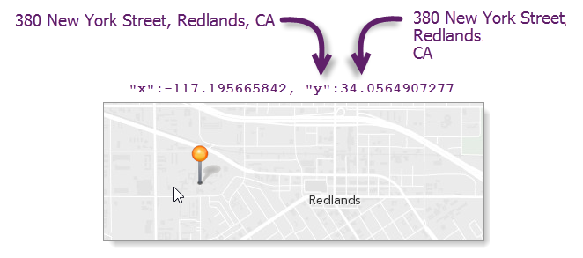
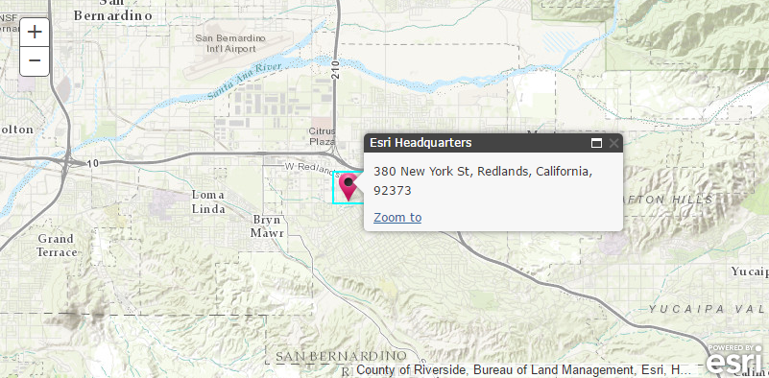
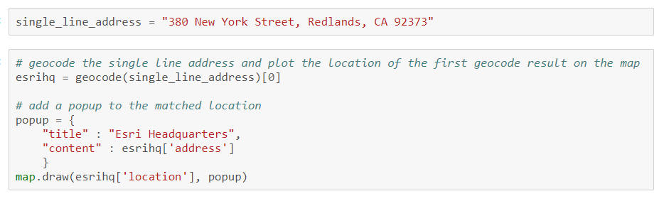
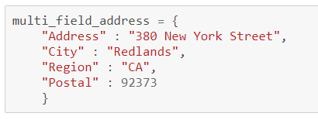
Geocode
Single line or multi field addresses

Slide 26
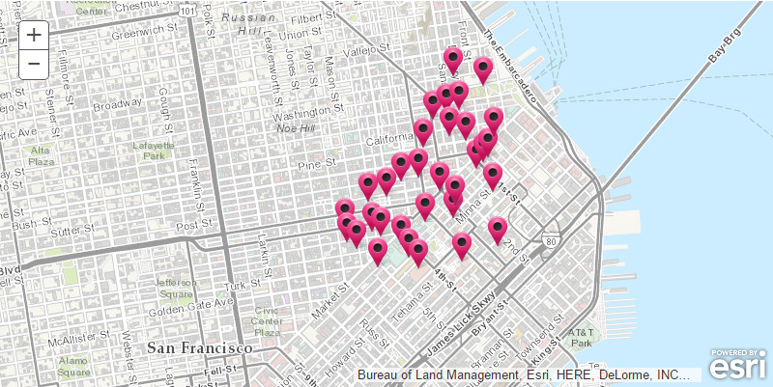
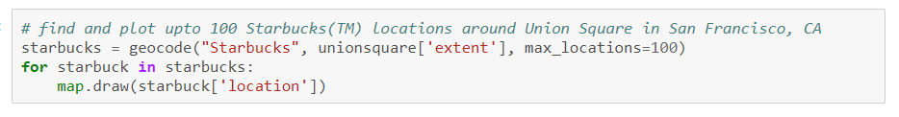
Geocode
Points of Interest
Cultural or geographic landmarks
Businesses by name or category
Administrative divisions

Slide 27
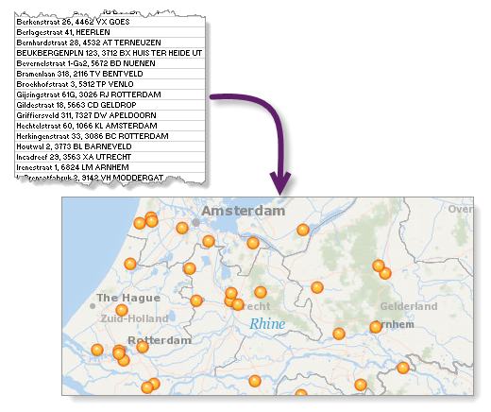
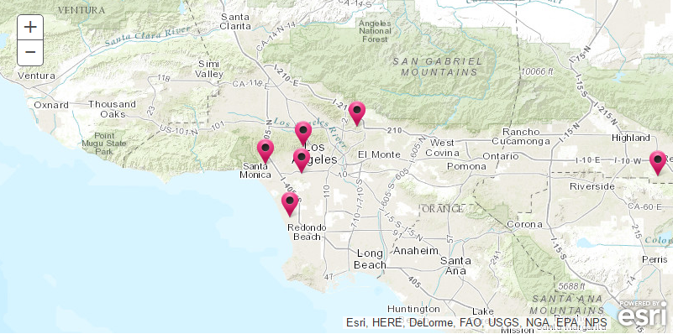
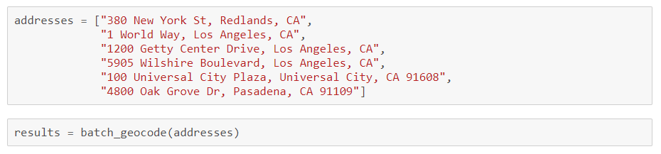
Batch Geocoding
Geocode an entire list of single line or multi field addresses

Slide 28
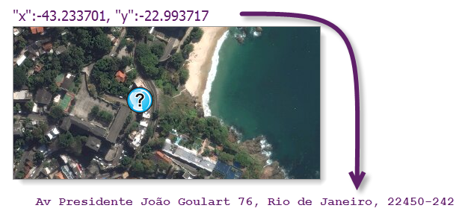

Reverse Geocode
Determines address at a particular x/y location

Slide 29
Demo
Geocoding Module
GIS in Python

Slide 30
Network Analysis
Routing and directions, location allocation, service areas…
arcgis.network.analysis module

Slide 31

Network analysis capabilities and tools
Commercial grade, traffic aware routing and directions for multiple travel modes

Slide 32


Network analysis – Service Areas

Slide 33
Demo
Network Analyst Module
GIS in Python

Slide 34
GeoEnrichment
Enrich your analysis with demographic and business data
arcgis.geoenrichment module

Slide 35



GeoEnrichment
Get facts about a location or area
Street addresses
Points, lines and polygon geometries
Within a drive time or service area
Named geographical areas
Counties or block groups in California
Districts and subdistricts in India
Create charts and choropleth maps

Slide 36



GeoEnrichment – create reports

Slide 37
Demo
Geoenrichment
GIS in Python

Slide 38
GeoAnalytics
Fast distributed spatio-temporal analysis of large vector and tabular data
arcgis.geoanalytics module

Slide 39


GeoAnalytics Tools
Summarize Data
Manage Data
Use Proximity
Find Locations
Analyze Patterns

Slide 40
Machine/Deep Learning
Insights and analysis into data.
arcgis.learn module

Slide 41

What is Machine Learning?
Subset of artificial intelligence
Uses the computer to “learn” how to deal with problems without “programming”
General Workflow:
Take data
Train a model
Use model to make predictions on new data

Slide 42

Flavors of Machine Learning
Supervised Learning: You give to the computer some pairs of inputs/outputs, so in the future new when new inputs are presented you have an intelligent output.
Unsupervised Learning: You let the computer learn from the data itself without showing what is the expected output.

Slide 43

Single Shot Detector
SSD has two components: a backbone model and SSD head.
Backbone model usually is a pre-trained image classification network as a feature extractor.
SSD divides the image using a grid and have each grid cell be responsible for detecting objects in that region of the image. Detection objects simply means predicting the class and location of an object within that region. If no object is present, we consider it as the background class and the location is ignored

Slide 44
Demo
arcgis.learn Module

